Slide 1
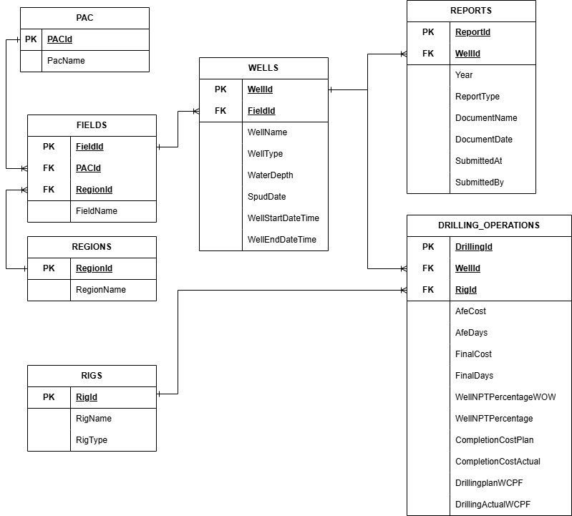
OVERVIEW
ERD DESIGN & EXPLANATION
The original data source is a denormalized flat table encompassing all drilling operations data, from PAC through to detailed operational records. This dataset is normalized by applying standard normalization techniques, including the elimination of data redundancy, the assignment of primary keys to each derived table, and the removal of transitive dependencies to ensure data integrity.

Slide 2
ENTITIES & ATTRIBUTES
PAC
Type | Column Name | Description
int | PACId, PK | Unique identifier for PAC
varchar | PacName | Production Asset Company Name
RIGS
Type | Column Name | Description
int | RigId, PK | Unique identifier for Rigs
varchar | RigName | Rig Name
varchar | RigType | Type of rig
REGIONS
Type | Column Name | Description
int | RegionId, PK | Unique identifier for Regions
varchar | RegionName | Region Name
FIELDS
Type | Column Name | Description
int | FieldId, PK | Unique identifier for Fields
int | RegionId, FK | Reference key to Regions table
int | PACId, FK | Reference key to PAC table
varchar | FieldName | Field Name

Slide 3
ENTITIES & ATTRIBUTES
WELLS
Type | Column Name | Description
int | WellId, PK | Unique identifier for Wells
int | FieldId, FK | Reference key to Fields table
varchar | WellName | Name of well
varchar | WellType | Type of well
float | WaterDepth | Water depth in m/ft
datetime | SpudDate | Date of Spud
datetime | WellStartDateTime | Date & Time Start of Well
datetime | WellEndDateTime | Date & Time End of Well
REPORTS
Type | Column Name | Description
int | ReportId, PK | Unique identifier for Reports
int | WellId, FK | Reference key to Wells table
varchar | ReportType | Type of Report
varchar | DocumentName | Name of Document
datetime | DocumentDate | Date of Document
datetime | SubmittedAt | Date of document being submitted
varchar | SubmittedBy | User who submitted the document

Slide 4
ENTITIES & ATTRIBUTES
DRILLING_OPERATIONS
Type | Column Name | Description
int | DrillingId, PK | Unique identifier for Drilling_Operations
int | WellId, FK | Reference key to Wells table
int | RigId, FK | Reference key to Rigs table
int | Year | Year of Operations
float | AfeCost | Plan Cost
int | AfeDays | Plan Days
float | FinalCost | Actual Final Cost
float | FinalDays | Actual Final Days
float | WellNPTPercentageWOW | NPT Percentage with Wait on Weather (WOW)
float | WellNPTPercentage | Overall NPT Percentage
float | CompletionCostPlan | Plan Completion Cost
float | CompletionCostActual | Actual Completion Cost
float | DrillingplanWCPF | Plan Well Cost per Foot (WCPF)
float | DrillingActualWCPF | Actual Well Cost per Foot (WCPF)

Slide 5
RELATIONSHIP & CARDINALITY
All relationship are based on one to many (1:N) relationship :
PAC to Fields (1:N) : One PAC can be associated with many fields, while each field can only belong to one PAC.
Regions to Fields (1:N) : One region can contain multiple fields, whereas each field is assigned to a single region.
Fields to Wells (1 : N) : One field can have multiple wells, while each well is associated with only one field.
Wells to Reports (1:N) : One well can have multiple type of reports generated for example NOOP & FWR. Each report is associated to a single well.
Wells to Drilling_Operations (1:N) : One well can have multiple drilling operations throughout it lifecyle.
Rigs to Drilling_Operations (1:N) : One rig can be used in multiple drilling operations.

Slide 6
NORMALIZATION DECISION
1NF
All repeating groups and multi-valued attributes (such as multiple operations, rigs, or reports within a single record) were decomposed into separate rows, ensuring atomic values and unique record identification
2NF
Partial dependencies were removed by separating data into distinct entities such as PAC, Regions, Fields, Wells, Rigs, Reports, and Drilling_Operations. Each non-key attribute was ensured to be fully dependent on the entire primary key of its respective table.
3NF
Transitive dependencies were eliminated by isolating attributes that do not directly depend on the primary key into their own tables. For example, hierarchical relationships such as PAC → Fields and Regions → Fields, as well as operational relationships such as Wells → Reports and Wells/Rigs → Drilling_Operations, were established using foreign keys. This normalization process resulted in a structured relational schema with well-defined one-to-many relationships, reduced data redundancy, and improved referential integrity across the dataset.

